Slide 1
Software Development Life Cycle (SDLC)
Process for software development

Slide 2
Agenda
Software Development Life Cycle Overview
Software Development Models
ISO 9001-2018 Overview for Software Development
Documentation Process

Slide 3
SDLC - Overview
What is SDLC?
The software development life cycle (SDLC) is a process
Planning
Writing / Developing
Modifying / Updating features new requirements
Maintaining
Notes:
Developers use the methodology as they design and write modern software for computers, cloud deployment, mobile phones, video games, and more.
Adhering to the SDLC methodology helps to optimize the final outcome.

Slide 4
SDLC - Overview
Why is SDLC Important?
it helps ensure that the right people are involved in the right activities at the right times. Using a structured approach to developing software helps ensure that your project will be successful. Some of the SDLC's benefits are
Understanding your requirements and the goal of the software
Identify risks at an early stage
Plan how you will deliver your solution in stages, such as building prototypes or writing functional specifications
Measure your progress relative to your goals and ensure everything is on track

Slide 5
SDLC - Overview
Stages of SDLC
Each stage in the SDLC has its own set of activities that need to be performed by the team members involved in the development project
the SDLC generally follows the stages outlined below
Planning / Brainstorm
Analyze Requirements
Design the Mockups
Develop the Code
Test the product
Implement and Launch the product
Set up Maintenance and Operations
Notes:
Planning
The first step in the software development life cycle is planning. It's when you gather the team to brainstorm, set goals, and identify risks. At this stage, the team will work together to devise a set of business goals, requirements, specifications, and any high-level risks that might hinder the project's success
Analyze
Once you've come up with some ideas, it's time to organize them into a cohesive plan and design. This requires a lot of research and planning to ensure that your final product meets your expectations (and those of your customers). The big step is creating a detailed project plan document and work breakdown structure that outlines the requirements.
Design the Mockups
Once you've got your design plans in front of you, it's time for wireframing and mockups. This step builds upon the planning stage, building out the tasks you need to do in the work breakdown schedule.
Develop the Code
The development phase is where coding begins to take place. It is one of the most time-consuming phases in the SDLC. This phase often requires extensive programming skills and knowledge of databases. The team will build functionality for the product or service, which includes creating a user interface and building the database so users can store information in your system
Test the Product
Before releasing the mockups into final production, you'll need to test it to ensure it is free of bugs and errors. Any issues need to be fixed before moving forward with deployment. You'll also need to manage how the system will integrate into existing systems, software, and processes
Implement and Launch the Product
Once you've completed all testing phases, it's time to deploy your new application for customers to use. After deployment, the launch may involve marketing your new product or service so people know about its existence. If the software is in-house, it may mean implementing the change management process to ensure user training and acceptance
Set Up Maintenance and Operations
The final stage of the software development life cycle is maintenance and operations. This is one of the most critical stages because it's when your hard work gets put to the test.
Maintenance involves updating an existing software product to fix bugs and ensure reliability. It can also include adding new features or functionality to a current product. Operations refer to the day-to-day running of a software product or service, such as performing backups and other administrative tasks

Slide 6
Software Development Models
There are six main software development approach models available in the market. Each has its own advantages and disadvantages.
They are listed below
Waterfall Model
V-Shaped Model
Iterative Model
Spiral Model
Agile Model
Big Bang Model

Slide 7
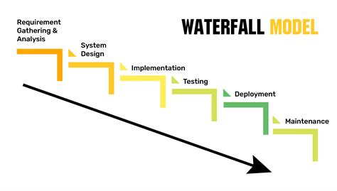
Software Development Models
Waterfall Model
The waterfall model remains one of the most popular process models in software development. Used since the 1970s, the waterfall model is a sequential design process that moves in a straight line from one phase to the next. Developers use this approach when the requirements for a product are well-defined and resources are available. However, it can perform inconsistently if requirements change frequently

Slide 8
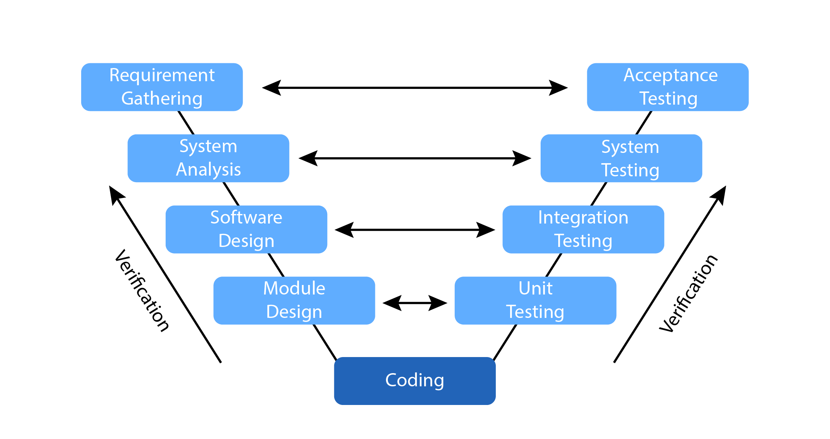
Software Development Models
V-Shaped Model
Also called the Verification and Validation model, the V-Shaped model allows for simultaneous development and testing. Like Waterfall, this model follows a linear progression, but you only move on to the next stage once the team finishes the previous one. The V-shaped model focuses on documentation and planning so it's ideal for large-scale projects with long schedules. However, the rigidity built into the system only allows for infrequent changes

Slide 9
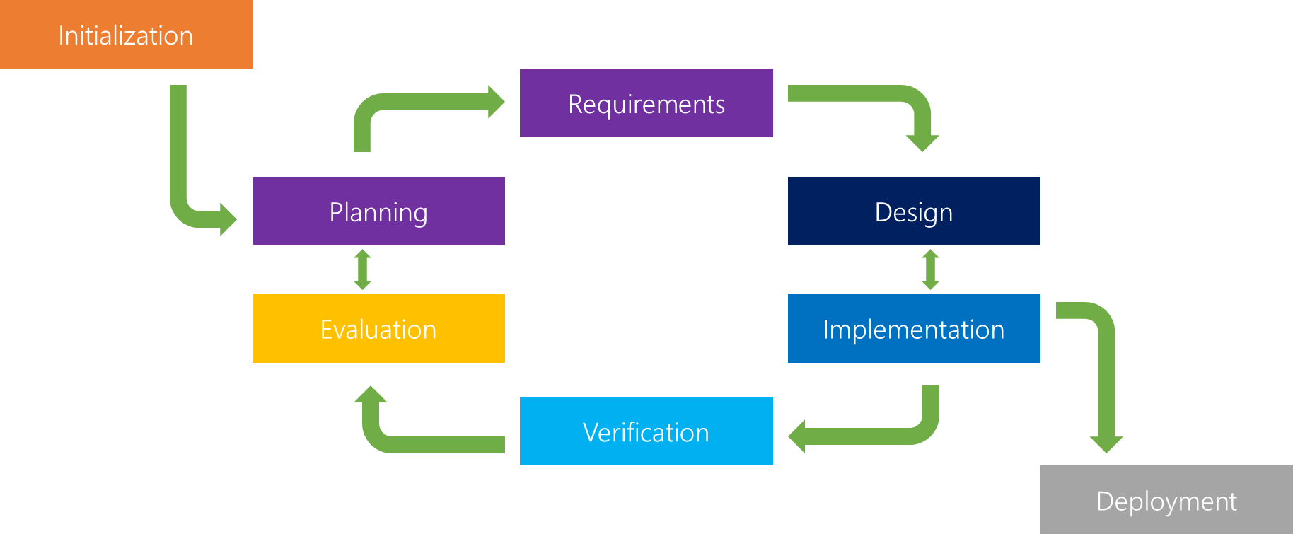
Software Development Models
Iterative Model
The iterative model organizes the development process into small cycles instead of a strictly linear progression. This allows developers to make changes incrementally and frequently so they learn from mistakes before they become expensive. Developers get feedback from users throughout the process with the iterative model, so it's ideal for large projects with a strong leadership team

Slide 10
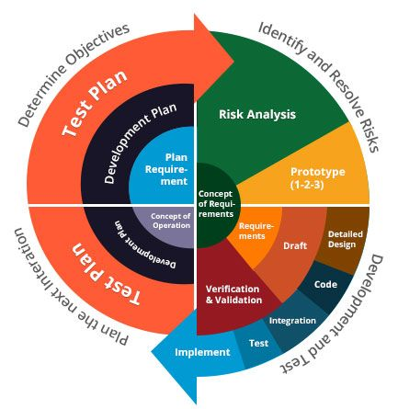
Software Development Models
Spiral Model
The spiral model combines elements of other models, namely Waterfall and Iterative. Developers work in shorter cycles, and the work within the cycles follows a linear progression. After each iteration, the software gradually gets better. The key advantage of this model is that it helps manage risk very effectively by focusing on small portions of risk at a time and using different approaches based on the risk profile at that stage. This allows developers to make adjustments without compromising the project's outcome. This approach works well in highly complex, large, expensive projects

Slide 11
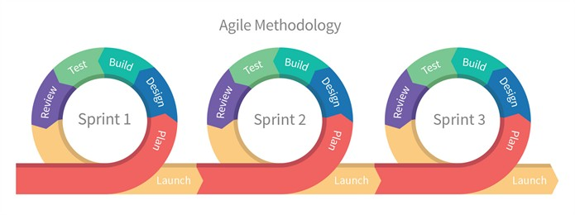
Software Development Models
Agile Model
The Agile software development process aims to deliver high-quality software early, often, and at a low cost. Agile methods prioritize working software over comprehensive pre-planning and documentation, which can slow the creative process. It is a modern approach with short phases that works well when software requirements are likely to emerge as the development process begins. The Agile model offers more flexibility than the Waterfall model, but it is not always suitable for large-scale projects with complex requirements because it lacks initial documentation

Slide 12
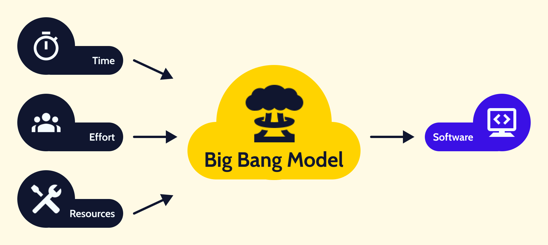
Software Development Models
Big Bang Model
Compared to other software development models, Big Bang has less structure. With this model, developers start working with little more than an understanding of the project requirements. They must figure out things as they go along, as they put most of the resources into the software development stage. Big Bang focuses on getting something working quickly. This approach works well with small projects, where one or two developers can work together to determine requirements and solutions as they code. However, it can be expensive and time-consuming for large projects

Slide 13
ISO 9001-2018 Overview for Software Development
ISO 9001 has become the quintessential international standard for quality management systems. Adopted by over 1 million global organizations, certification helps companies streamline operations, boost customer satisfaction, and align processes with strategic objectives, laying down a framework that ensures a brand’s products or services meet and often exceed customer and regulatory benchmarks
What is ISO 9001?
it is an international standard published by the International Organization for Standardization that outlines requirements for a comprehensive quality management system (QMS). It helps organizations establish policies and objectives that meet customer needs and improve overall performance

Slide 14
ISO 9001-2018 Overview for Software Development
What is Quality Management System (QMS)?
it’s a formalized set of policies, processes, procedures, and responsibilities that an organization establishes to ensure its products or services meet the required quality standards. It acts as a framework that guides and directs an organization to achieve and maintain consistent product quality, resulting in enhanced customer satisfaction and continuous improvement
Core Components of a QMS
Policy and Objective Setting
Process and Procedures
Document Control
Resource Management
Product Realization
Measurements, Analysis and Improvement
Continuous Improvement
Notes:
Policy and Objective Setting
The organization defines its quality policy—a statement of intent regarding its commitment to quality—and sets measurable objectives based on this policy
Process and Procedures
The organization establishes standardized processes and procedures to ensure tasks and activities are carried out consistently, leading to predictable outcomes
Document Control
Documentation, whether in manuals, records, or electronic files, is controlled to ensure accuracy, relevance, and accessibility
Resource Management
Resources, including human resources, infrastructure, and the work environment, are managed to ensure they can support the delivery of quality products or services
Product Realization
All steps from design and development to product or service delivery are managed to ensure they meet quality criteria and customer requirements
Measurements, Analysis and Improvement
The organization sets up mechanisms to measure and analyze various metrics (like customer satisfaction or product conformity) and implements corrective actions if deviations are detected
Continuous Improvement
Based on data, feedback, and analysis, the QMS promotes a culture of continuous improvement, refining processes and methodologies over time

Slide 15
Documentation Process
Documents involved in the SDLC
System Requirements Specifications
Detail Design Requirements
Acceptance Test Procedures
Code Review
Secure Code Review
Software Version Description

